Slide 1
Security Engineering 101 Ethical Hacking
Mrinal Wahal
IIT Madras, Research Park

Slide 2
Lessons I learned the Hard Way !
Windows == Sucks & Linux == Rocks.
Programming elevates your advantages.
C|EH != Real Hacking & CISSP == Real Hacking.
Thou can never learn entire field of Security.
Knowledge of Networking is Paramount.

Slide 3
Agendas
Foot Printing
Scanning -- NMap
Enumeration
System Hacking -- Metasploit
Phishing -- Social Engineering Toolkit
Steganography
Proxies
Internet Protocol
Malware & viruses
Trojan
Sniffing
Cryptography

Slide 4
Languages Required
Python [ 2.7 or above]
Ruby
Shell Scripts
Perl
C/C++

Slide 5
Foot printing
Collecting much information about target & victim
website
organization
Network
person

Slide 6
How information store ?
Active information
Internet foot printing

Slide 7
Location
By using Google earth
By using satellite picture
By using Google map

Slide 8
Information about website
www.yougetsignal.com
Domain name
IP Address
Place
Server name
Network block
TCP & UDP service

Slide 9
Information about people
Pipl.com
Intelius.com
Bestpeoplesearch.com
Anywho.com
Peoplefinder.com
Webextrator.com
Binarypool.com
Robtex.com

Slide 10
Search engine machine
Google.com
Bing search bar
Yahoo search bar
Facebook
Twitter

Slide 11
How to protect yourself
Don’t register in any website
Don’t come with your real name and identity to internet
Don’t trust anyone in internet
Don’t post your photo & video in any website
Hide your IP Address
Hide your MAC Address
Don’t use public computer
Don’t use cyber cafe

Slide 12
Scanning
IP scan
Port scan
Vulnerability
networking

Slide 13
IP Address you should not ping & scan
GOVT IP ADDRESSES
Army Information Systems Center
Defense Information Systems Agency
Royal Signals and Radar Establishment
NASA Ames Research Center
NASA Lewis Network Control Center
NASA Johnson Space Center
Air Force Academy
Langley Air Force Base

Slide 14
TOOLS
Ping pocket
Angry ip scanner
Solar wind engineer toolset
Nmap
www.angryip.com
www.solarwinds.com

Slide 15
PROTECT
Close all open ports
Firewall
Comodo firewall
Firewall zen alarm
Use vpn
Use proxy

Slide 16
What are Firewalls?
Oh wait dude.... Go slow. Rewind.
How do they work?

Slide 17
IP & proxy
What is an IP address
What is mac address
What is proxy

Slide 18
IP v4 & ip v6
How to change your ip
Wow to find location by ip
How to trace an email by ip

Slide 19
PROXY
Psiphon
Anonymiser.ru
Anonymous-surfin.com
Hotspot shield
Tor browser

Slide 20
Enumeration
Another exaggerated security word.

Slide 21
ENUMERATION
What is enumeration
Super scan enumeration
Dnsstuff.com

Slide 22
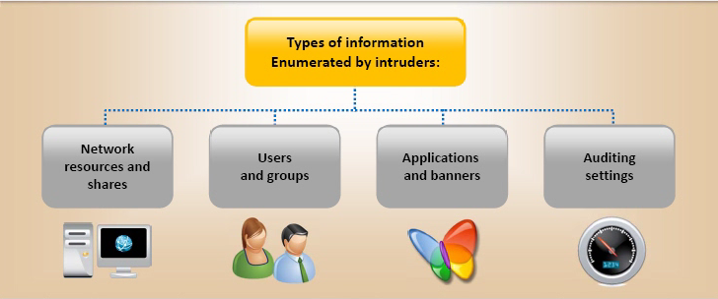

Slide 23
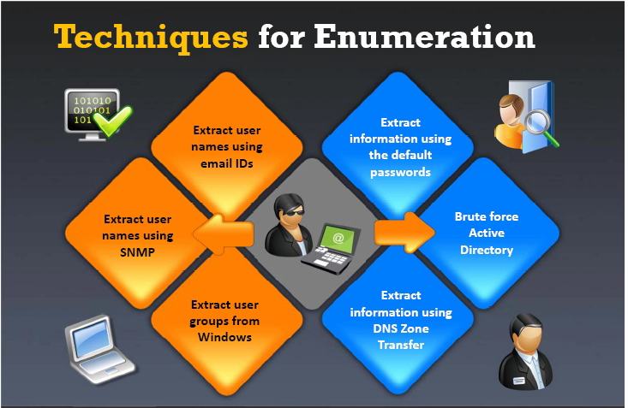

Slide 24
Tools for enumeration
Net bios enumeration
Super scan enumeration
Cmd
Ip network browser tools

Slide 25
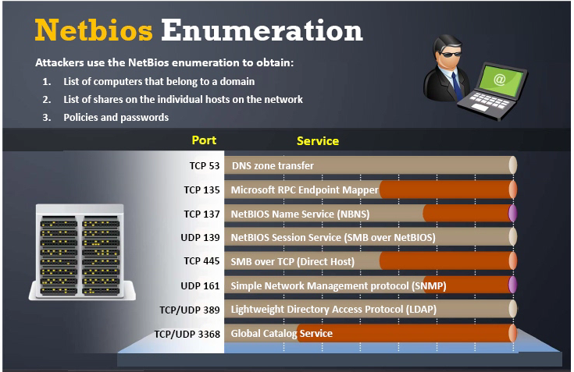

Slide 26
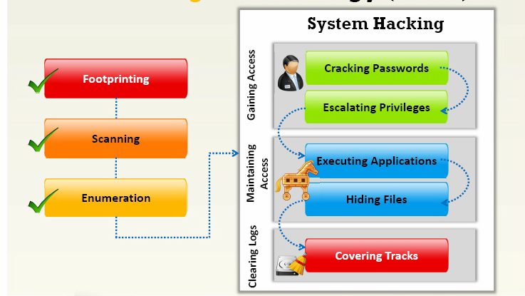

Slide 27
System & Password Hacking
Brut force
Dictionary
Software
Key logger
Live boot
Linux
Hardware

Slide 28
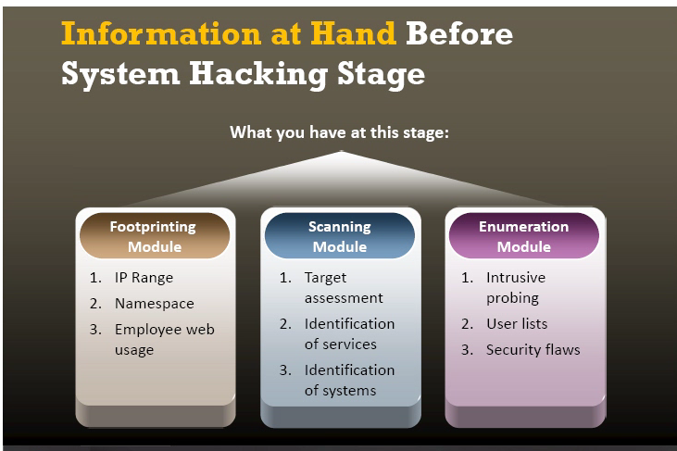

Slide 29
How to attack on password
Default password
Common password
Social engineering
Guess password
Online attack
Software attack

Slide 30
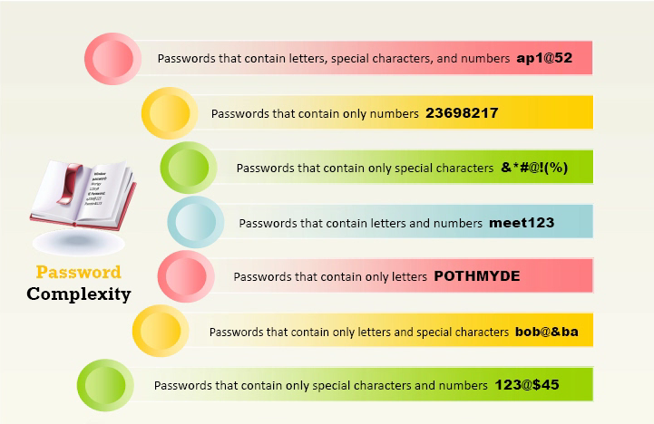

Slide 31
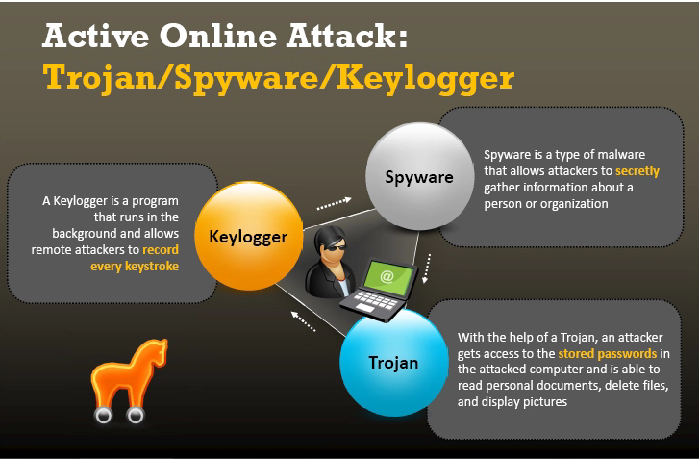

Slide 32
Tools
Cain password cracker
Elcom software
Active @password change

Slide 33
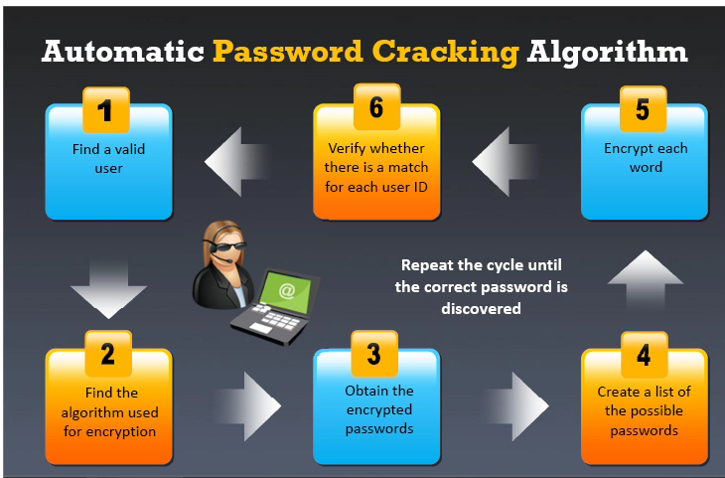

Slide 34
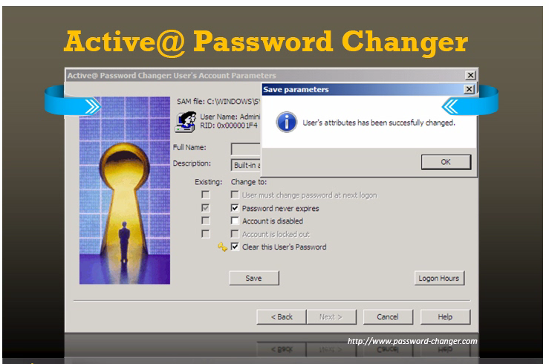

Slide 35
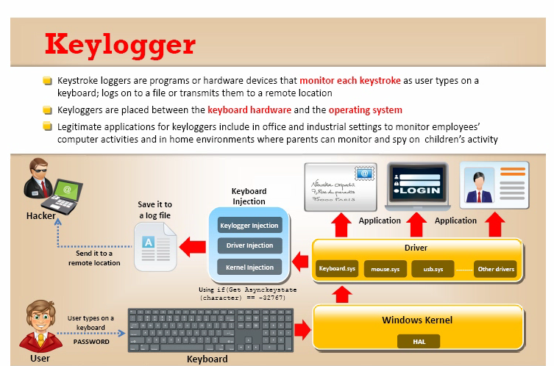

Slide 36
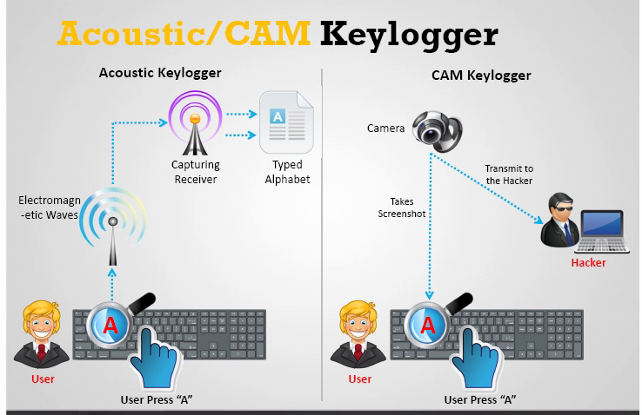

Slide 37
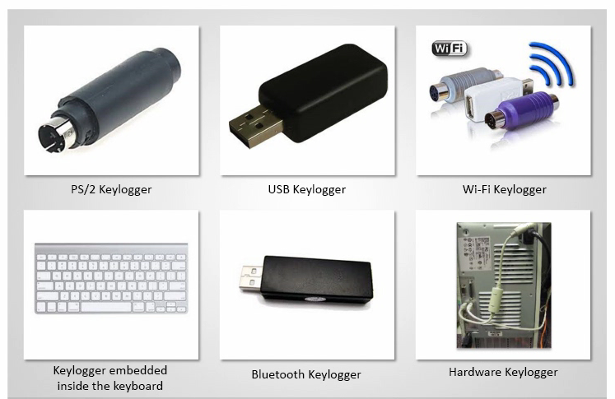

Slide 38
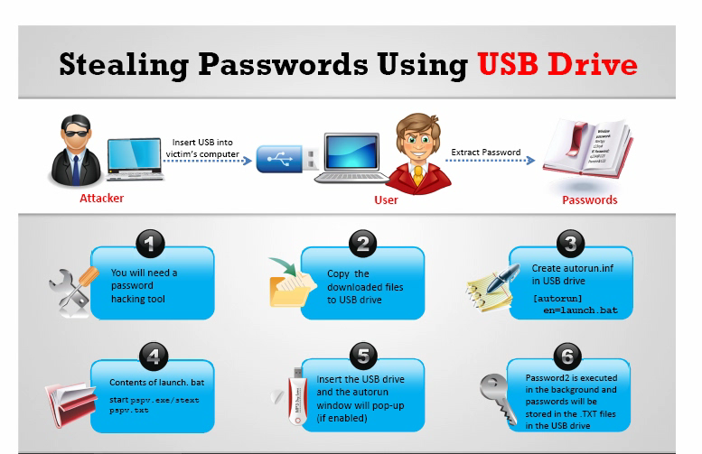

Slide 39
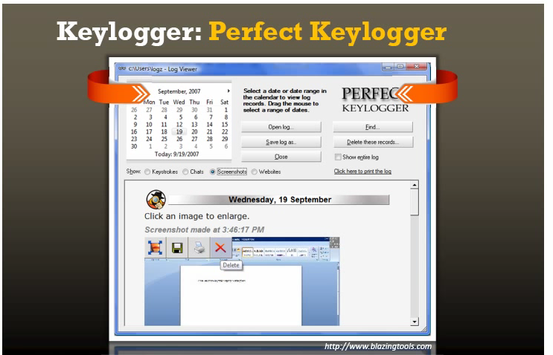

Slide 40
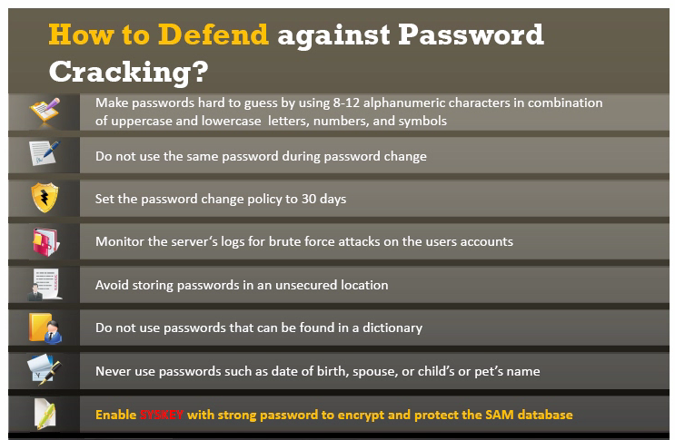

Slide 41
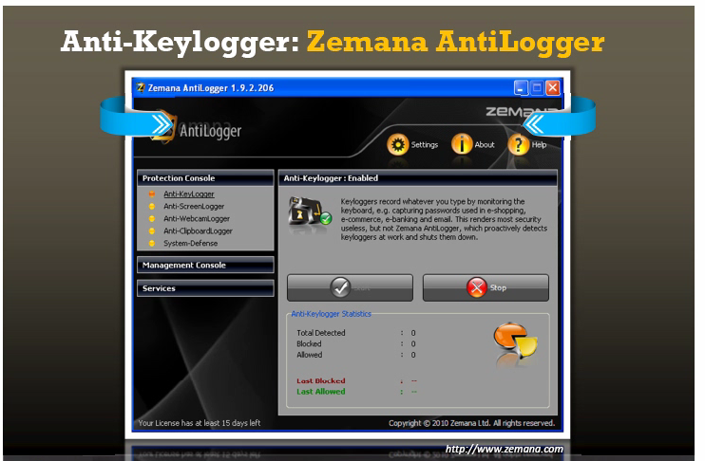

Slide 42
Spy ware
What is spyware and its type
How does it work

Slide 43
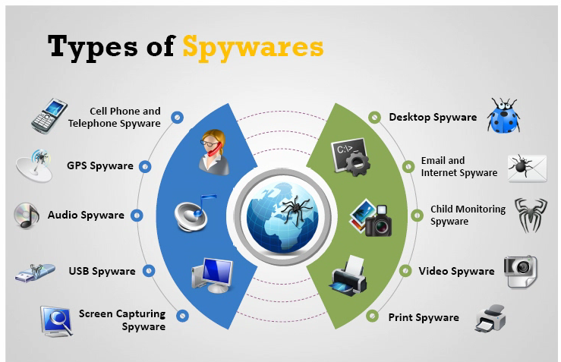

Slide 44
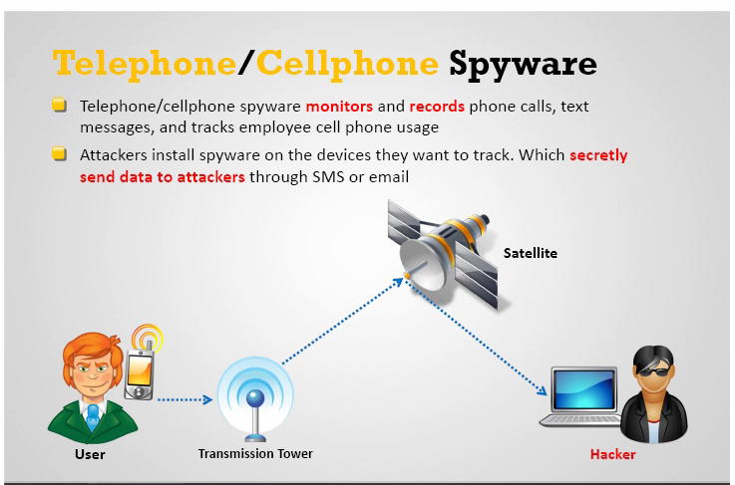

Slide 45
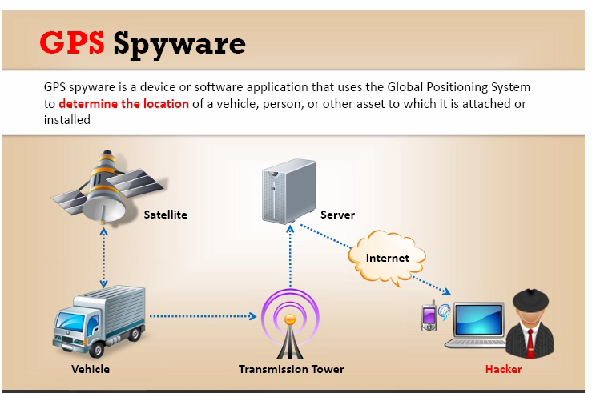

Slide 46
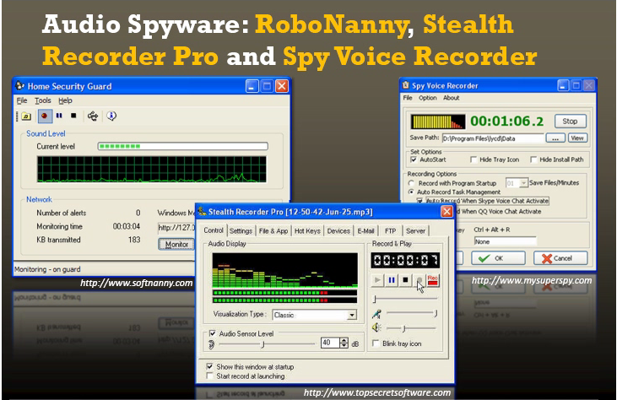

Slide 47
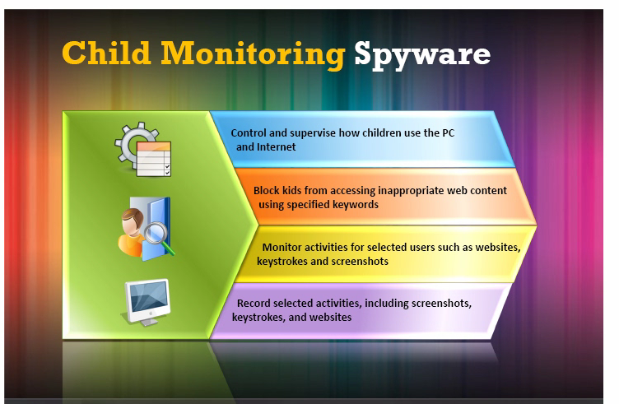

Slide 48
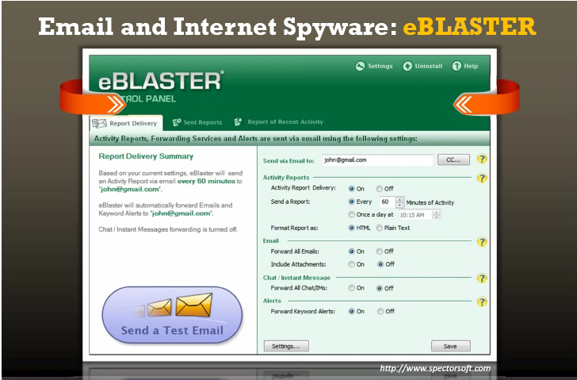

Slide 49
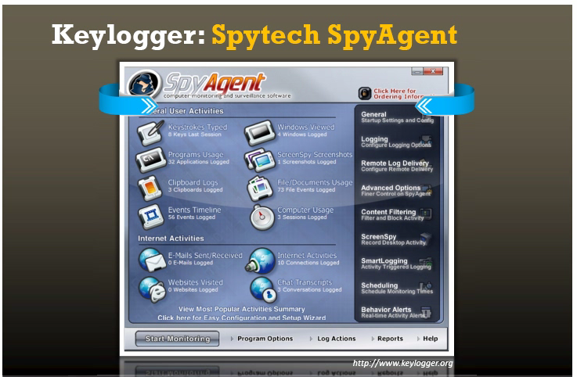

Slide 50
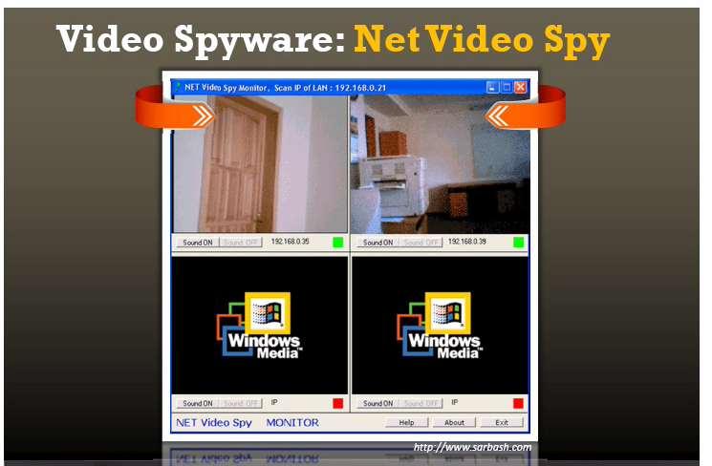

Slide 51
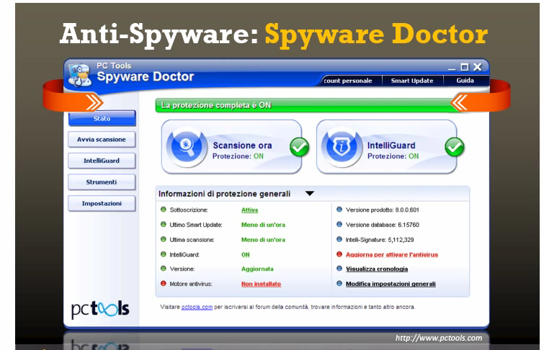

Slide 52
Trojan
What is Trojan
How does it work
How Trojans come to the system

Slide 53
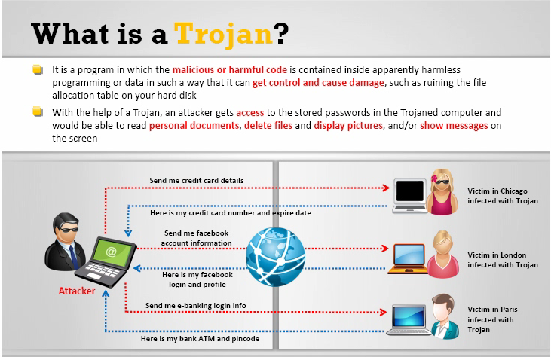

Slide 54
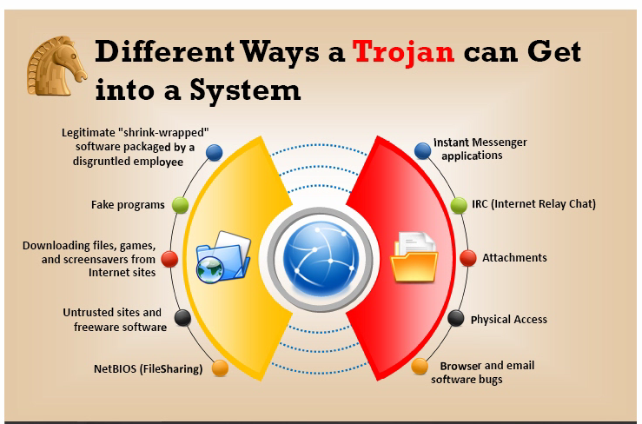

Slide 55
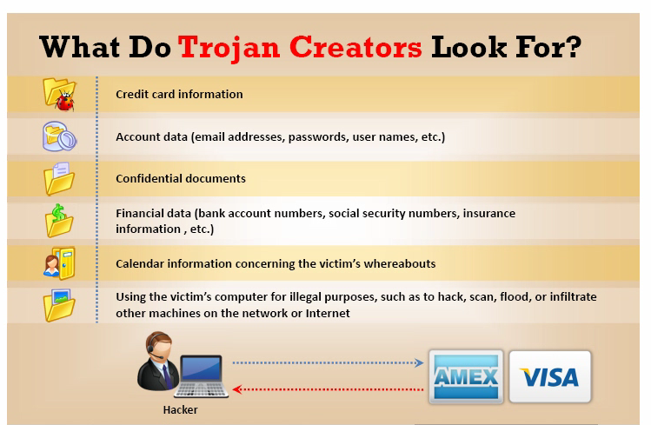

Slide 56
TYPE OF TROJAN
Command shell Trojan
GUI Trojan

Slide 57
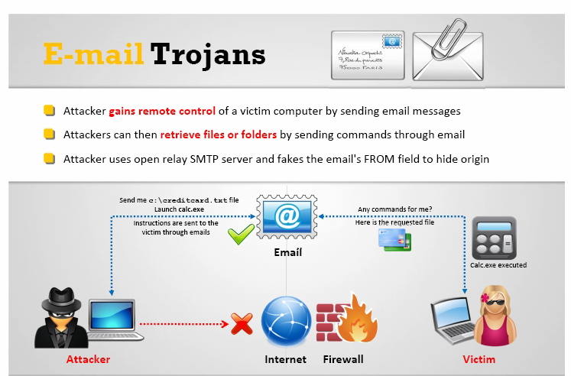

Slide 58
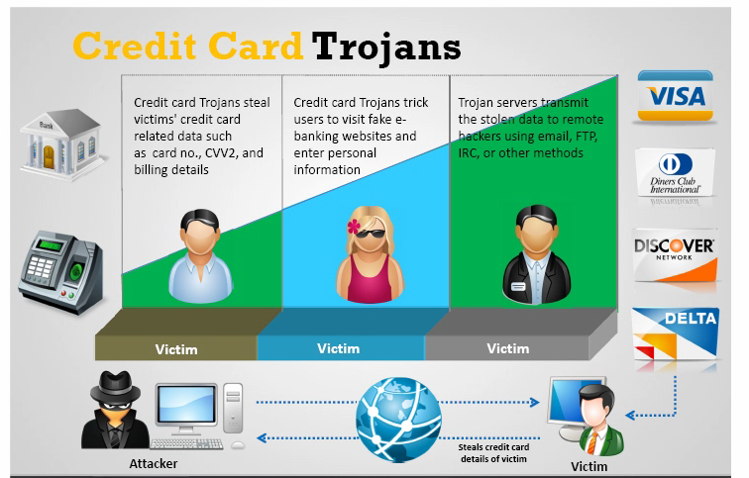

Slide 59
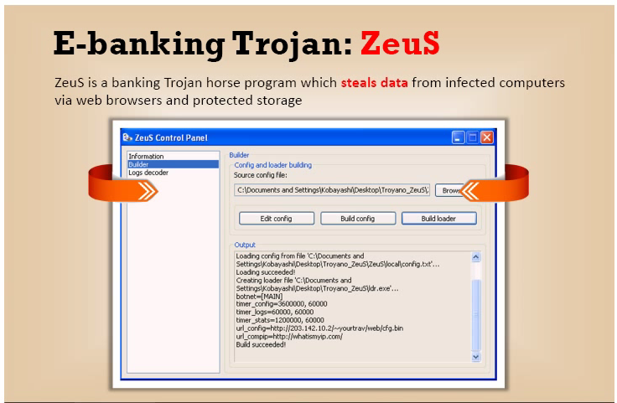

Slide 60
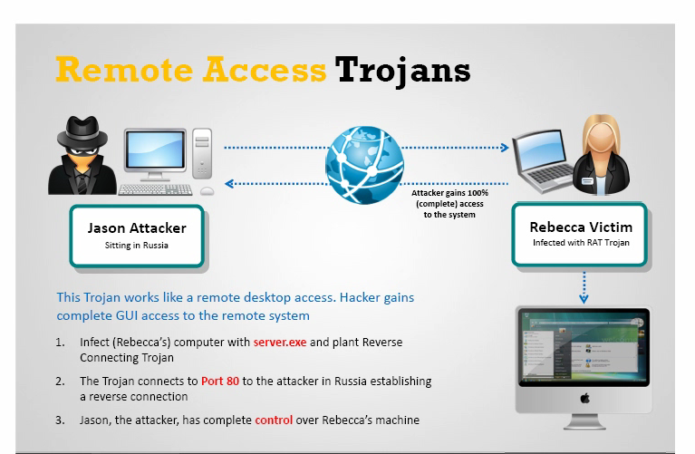

Slide 61
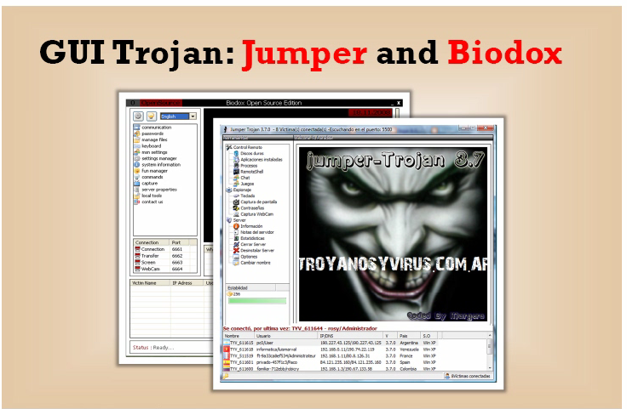

Slide 62
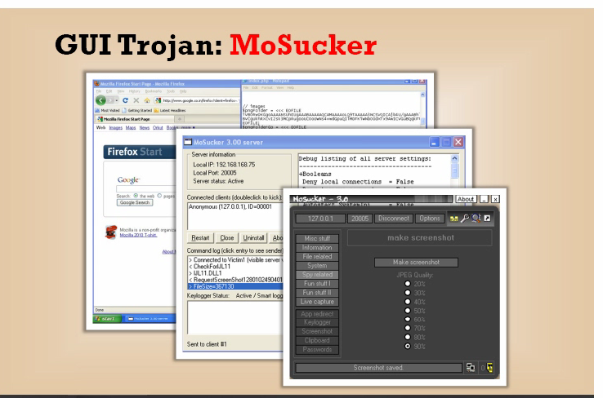

Slide 63
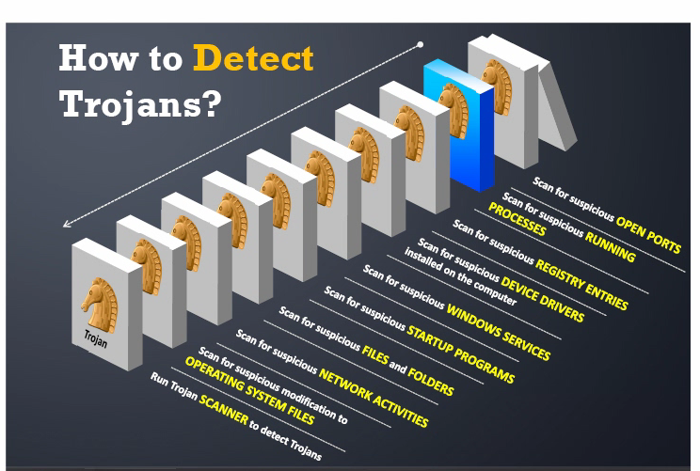

Slide 64
Software for removing Trojan
Net stat –an
Port monitor tool
Process monitor tool
Starter tool
Trojan hunter
TCP view

Slide 65
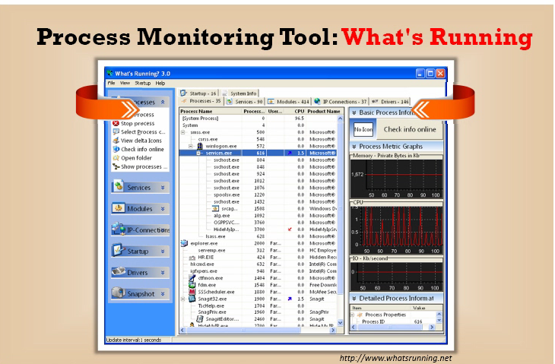

Slide 66
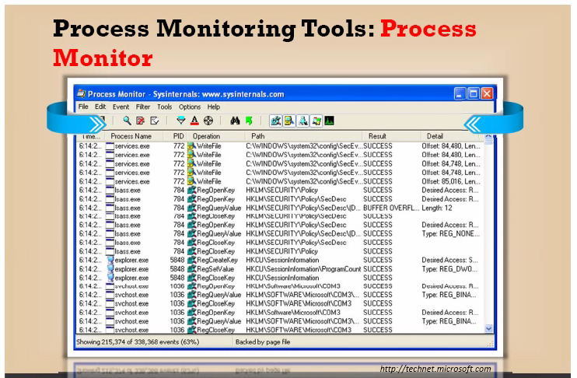

Slide 67
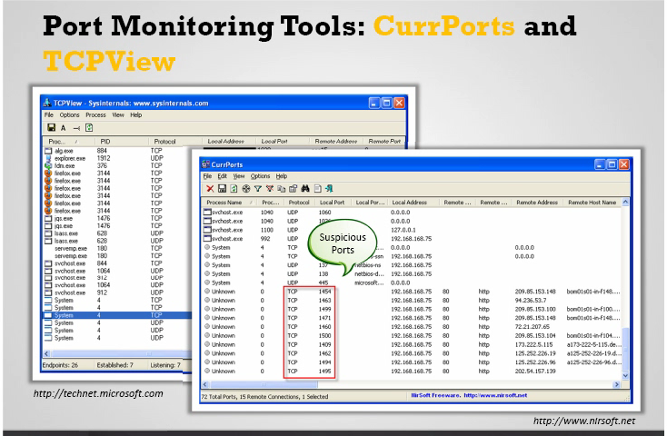

Slide 68
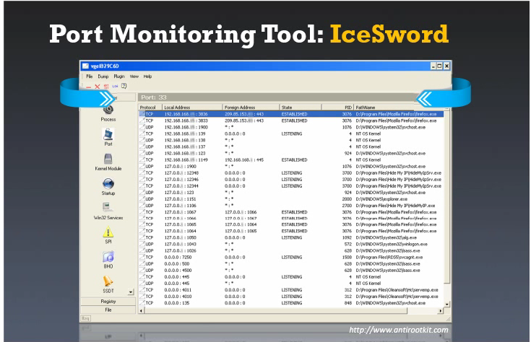

Slide 69
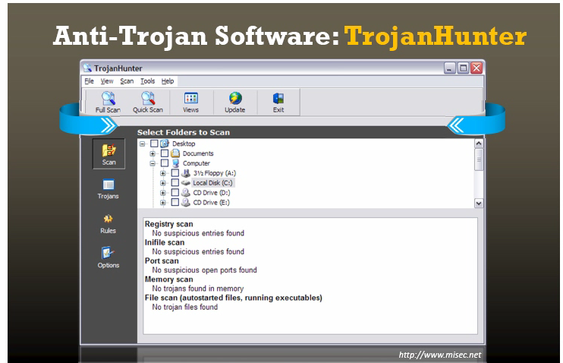

Slide 70
VIRUS AND WARM
What is a virus
Infection of phase
Why people do create virus
How viruses come
How to remove

Slide 71
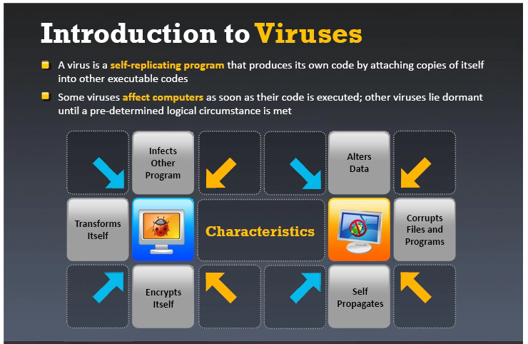

Slide 72
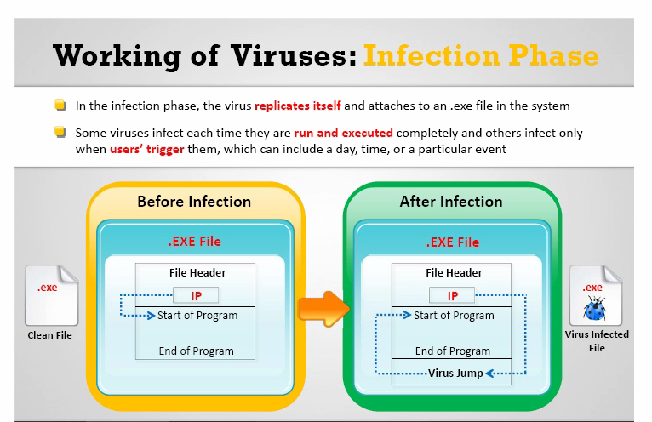

Slide 73
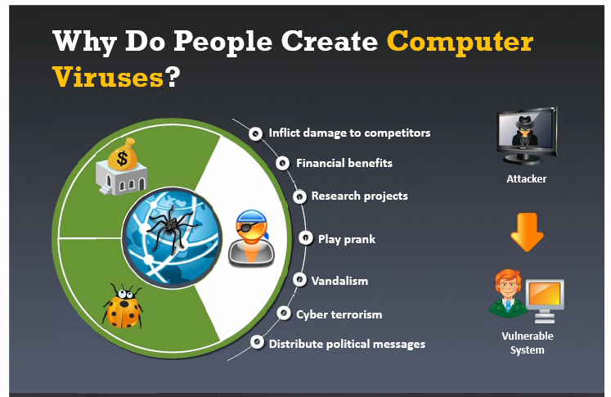

Slide 74
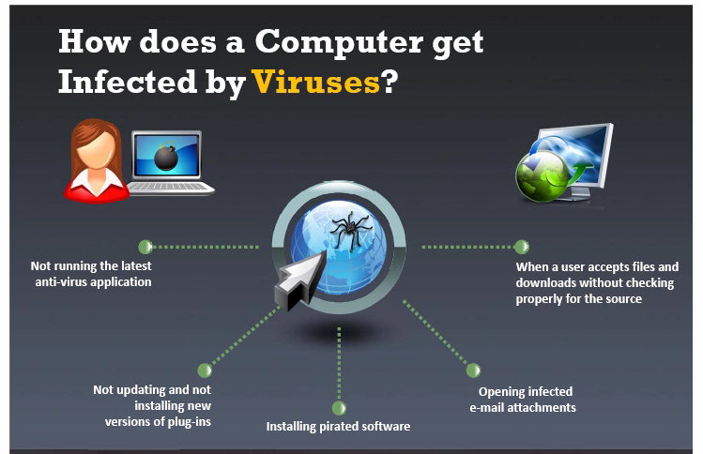

Slide 75
Types of viruses
System or boot sector viruses
File and multimedia viruses
Macro viruses
Cluster viruses
Encryption viruses
File extension viruses

Slide 76
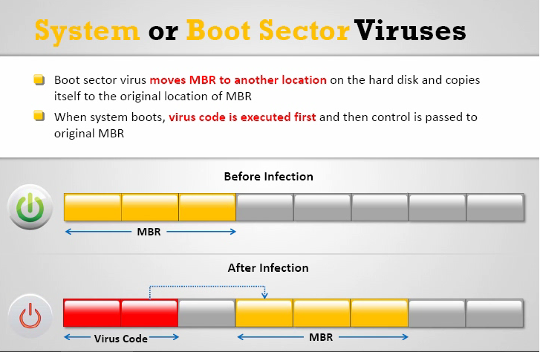

Slide 77
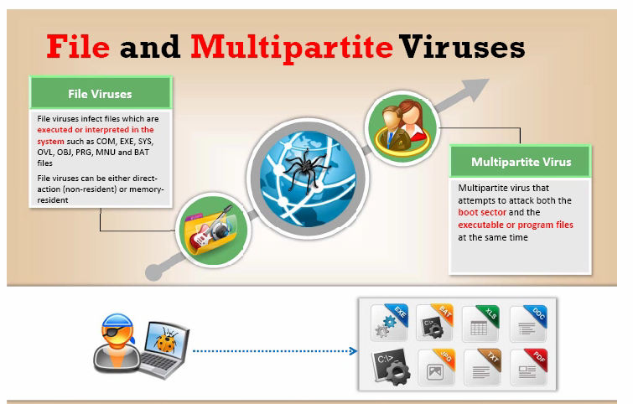

Slide 78
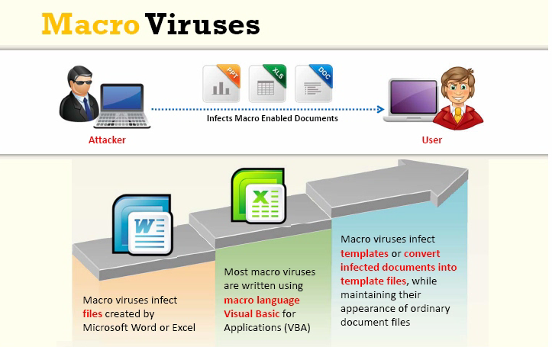

Slide 79
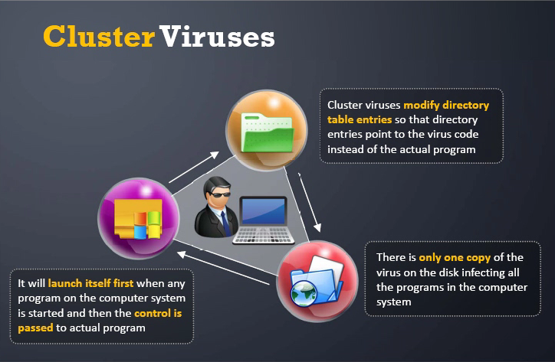

Slide 80
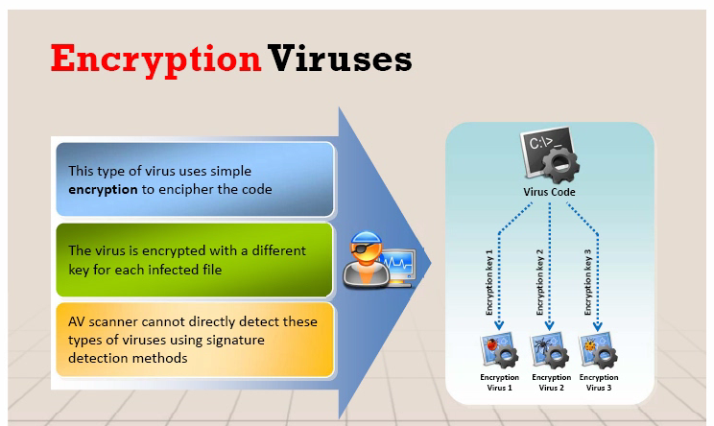

Slide 81
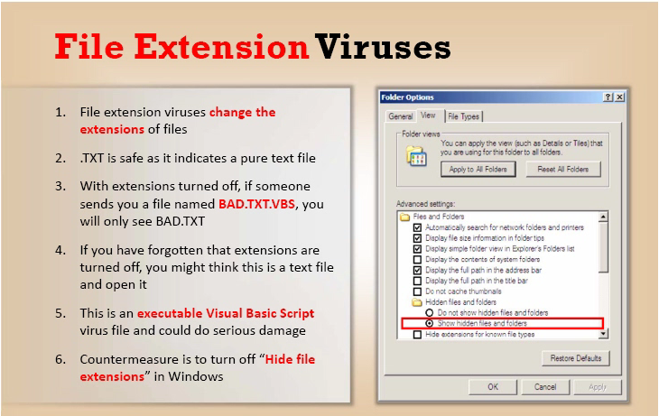

Slide 82
How to remove viruses from computer
Antiviruses sensor
Process monitor tool
Debugging tool
Installing antivirus
Scanning each file
Entry checking
Viruses and warm countermeasures

Slide 83


Slide 84


Slide 85


Slide 86


Slide 87


Slide 88
SNIFFING
How sniffer works
Types of sniffing
Hard ware devices for sniffing
Cain software
Mac sniffing

Slide 89


Slide 90


Slide 91


Slide 92


Slide 93


Slide 94
How to detect
Don’t use physical address
Encrypt your data
Use static IP
Turn off network identification
Use IP v6 instead of IP v4
Sniffing detective technique
Promise scan tool
Promqry UI software

Slide 95


Slide 96
Next-Gen Research Scopes
" If it's already advanced how we will progress with this futher ? "
Artificial Intuition
Artificial Immune Systems
Advanced Self-Driving Cars (Computer Vision)
Imaging Human Thoughts

Slide 97
Resources
www.Gitlab.com/Wahal
MrinalWahal@gmail.com
91 + 9560892906
PDFs
Cheat Sheets
Python Pre-Written Codes

Slide 98
Let's Distribute Links !
SANS Institute
Hacking Tools/Books Mega Link
NMap Documentation
Offensive Security Pages
Kali Images

Slide 99
" In foreign sand, your knowledge is your rich possession. In the battlefield, your practical skills are your rich possession. Inside home, your wife/husband is your rich possession. On the death bed, the most efficacious medicine is your rich possession. But throughout life and beyond, your Dharma is your Kohinoor. "
~ Chanakya

